Slide 1

Uber A/B Testing Project Presentation
By : Amar
Professional Data Science and AI Course Newton School September 2025

Slide 2
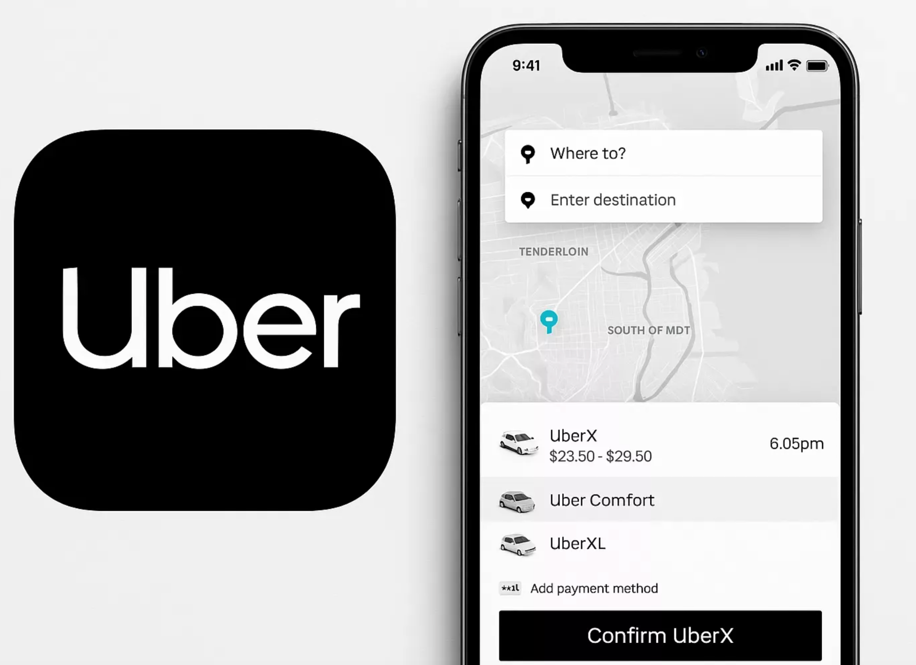
Business Problem
Objective
Uber redesigned its Partner App to improve the onboarding experience for new drivers.
Key Business Questions
Does the redesigned app improve driver activation?
Which signup channels perform best?
Which factors influence successful onboarding?
Should Uber launch the redesigned app for all users?

Slide 3
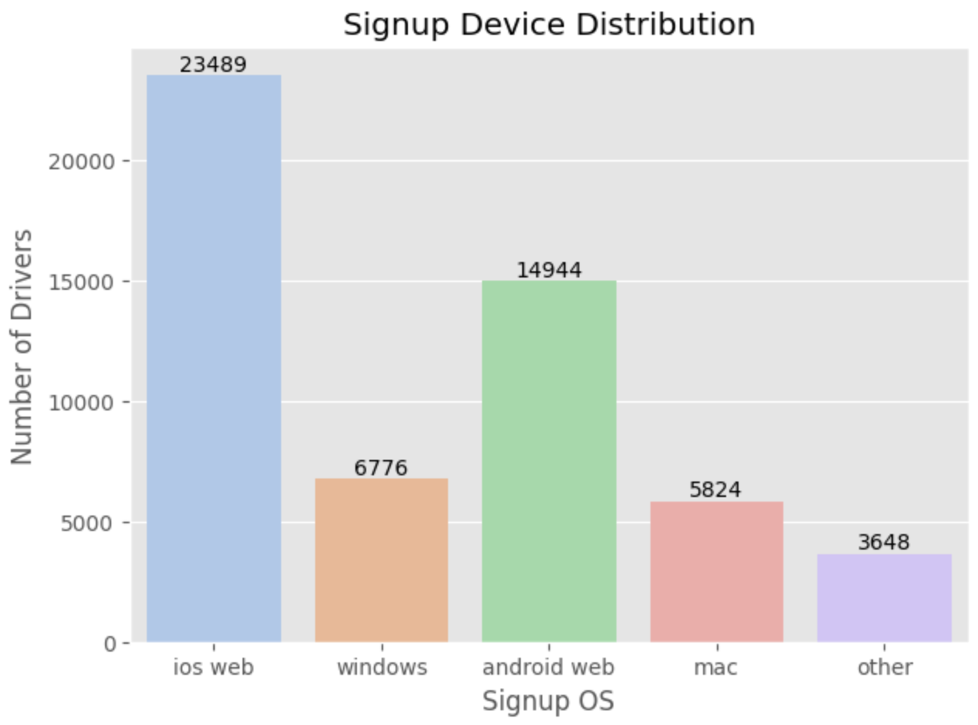
Data Overview
Features | Description
Total Records | 54,681
Total Variables | 12
Experimental Groups | Control and Treatment
Target | First Ride Completion

Slide 4
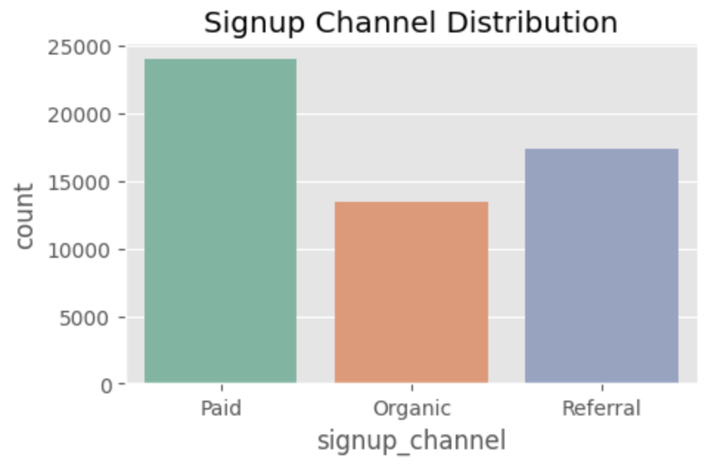
Signup Channel
Paid: ~24,000 signups — highest volume
Referral: ~17,500 signups — second highest
Organic: ~13,500 signups — lowest volume
Key Insights
Paid is the largest contributor to driver acquisition.
Referral performs strongly, highlighting the potential of word-of-mouth recruitment.

Slide 5
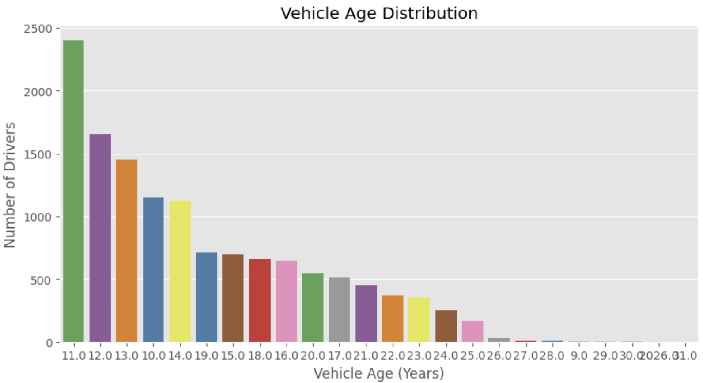
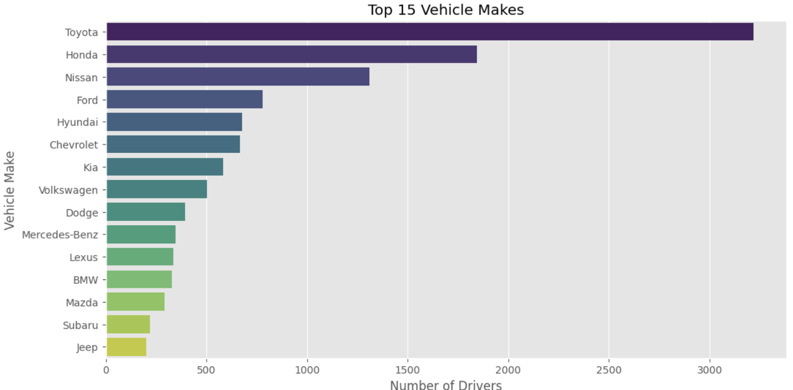
Vehicle Makes
Vehicle Age: 11–13-year-old vehicles account for the largest share of the dataset.
Vintage Vehicles: Very few older/vintage vehicles are present.
Toyota Leads: Toyota is the most common make, with 3,200+ vehicles.
Japanese Brands: Honda (~1,850) and Nissan (~1,300) are also highly represented.
Competitive Tail: Brands such as Hyundai and Jeep have smaller volumes, generally ranging from 200–700 vehicles.

Slide 6
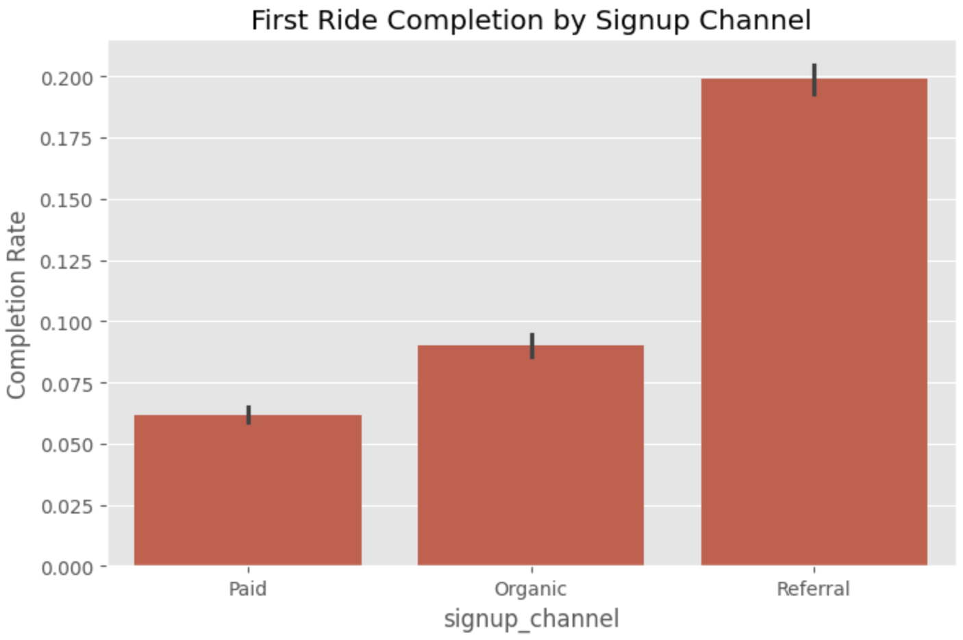
Driver Activation
Highest Conversion: Referral signups have the highest activation rate at 20.0%.
Moderate Conversion: Organic signups achieve an activation rate of 9.0%.
Lowest Conversion: Paid signups have the lowest activation rate at 6.2%.

Slide 7
Executive Summary
Key Findings from the Onboarding Experiment
Baseline Activation: Overall Driver Activation Rate was 11.22%.
A/B Test Result: Treatment (11.27%) and Control (11.17%) showed no statistically significant difference (p = 0.70).
Predictive Modeling: The Random Forest model achieved 93% accuracy, highlighting key behavioral and onboarding factors linked to activation.

Slide 8
A/B Test and Channel Performance
Strategic Segmentation Opportunities
Referral Channel: Leads with the highest activation rate at 20%.
Paid & Organic: Show lower activation rates of approximately 6–9%.
Recommendation: Prioritize Referral programs and incentives to improve acquisition efficiency and activation.

Slide 9
The "Golden Window" of Driver Intent
Behavioral Velocity as a Success Predictor
Top Predictors: Vehicle Age, BGC-to-Vehicle Upload time, and Sign Up-to-BGC time.
Key Insight: Faster onboarding progress is associated with higher activation potential.
Intervention: Use timely nudges to support drivers who slow down during the BGC stage.

Slide 10
Regional Activation Variance
City-Level Performance Gaps
Berton: Highest activation rate at 12.1%.
Wrouver: Lower activation at 9.2%, indicating potential onboarding friction.
Recommendation: Consider localized incentives and onboarding support in Wrouver to improve activation.

Slide 11
Strategic Roadmap: Phase 2
Data-Driven Action Plan
Segmented Rollout: Prioritize Referral drivers and newer-vehicle segments for further testing.
Technical Improvement: Introduce OCR for vehicle-document uploads to reduce friction and manual effort.
Testing Strategy: Adopt Switchback Testing to account for city-level supply and demand effects.

Slide 12
Recommendations
Invest in High-Performing Channels: Increase focus on channels with stronger activation rates.
Speed Up Background Checks: Reduce delays in the early onboarding process.
Simplify Vehicle Onboarding: Make document and vehicle uploads easier.
Support Lower-Performing Cities: Introduce targeted onboarding support where activation is lower.
Scale with Evidence: Roll out the redesigned app only after confirming a statistically significant improvement.
Monitor Continuously: Track activation and onboarding performance after launch.

Slide 13
Conclusion
Driver Activation Rate should remain the primary KPI for evaluating the redesigned Uber Partner App.
The current A/B test did not show a statistically significant improvement in activation.
Therefore, a full rollout is not recommended yet.
Continue refining onboarding, reducing friction, and testing targeted improvements.
Proceed with a phased rollout once a statistically significant improvement is demonstrated without negatively affecting onboarding performance.

Slide 14
Thank You

